Slide 1
water desalination plant

Slide 2


The presentation is divided into two topics
Manufacturing
Sensors and actuators

Slide 3
In the manufacturing part
Two types
Membrane desalination
Thermal desalination

Slide 4
In the first type(Membrane desalination)
Reverse Osmosis (RO)
Structure
Flow rate
Electrodialysis (ED) - Membrane-Based Desalination

Slide 5
Membrane desalination
In Reverse Osmosis (RO)
Diagram
Principle
Pros and cons

Slide 6
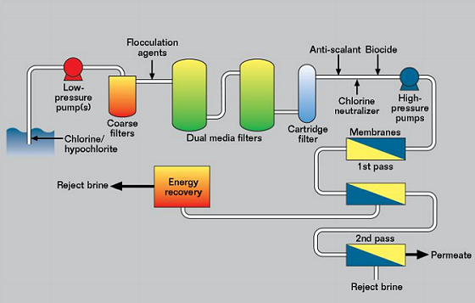
Reverse Osmosis (RO)
Diagram

Slide 7
Reverse Osmosis (RO)
Principle
Utilizes the principle of semipermeable membranes to remove salts and impurities.

Slide 8
Reverse Osmosis (RO)
Process
Saline water is pre-treated to remove large particles and impurities.
High pressure is applied to push the water through a semipermeable membrane.
The membrane allows water molecules to pass while blocking salts and other contaminants.
Freshwater (permeate) is collected, and the concentrated brine (reject water) is discharged.

Slide 9
Reverse Osmosis (RO)
Pros
Cons
high efficiency
Widely used in desalination of seawater and brackish groundwater
high energy consumption
Sensitive to pollution and the membrane requires periodic maintenance

Slide 10
Membrane desalination
Structure
Intake System
Pre-Treatment System
Desalination Unit
Post-Treatment System
Brine Disposal System

Slide 11
Structure of intake system
It combines of
Offshore intake pipes or wells.
Screens to prevent debris and marine life from entering.
Pumps to transport water to the pre-treatment system.

Slide 12
Structure of pre-treatment System
Function
Processes
Prepares the raw water by removing large particles, sediments, and microorganisms to protect downstream equipment.
Coagulation and flocculation.
Sedimentation.
Filtration (sand filters or ultrafiltration membranes).
Chemical dosing (e.g., chlorine for disinfection).

Slide 13
Structure of desalination Unit
Function
Types
Removes dissolved salts and impurities to produce freshwater.
Membrane-Based.
Thermal-Based.

Slide 14
Structure of post-treatment System
Function
Processes
enhances the freshwater to meet drinking water quality standards.
pH adjustment.
Addition of minerals (e.g., calcium, magnesium) for taste and health.
Final disinfection.

Slide 15
Structure of brine disposal System
Function
Methods
Handles the discharge of concentrated brine.
Direct discharge into the ocean with proper mixing.
Brine treatment or use in industrial processes.

Slide 16
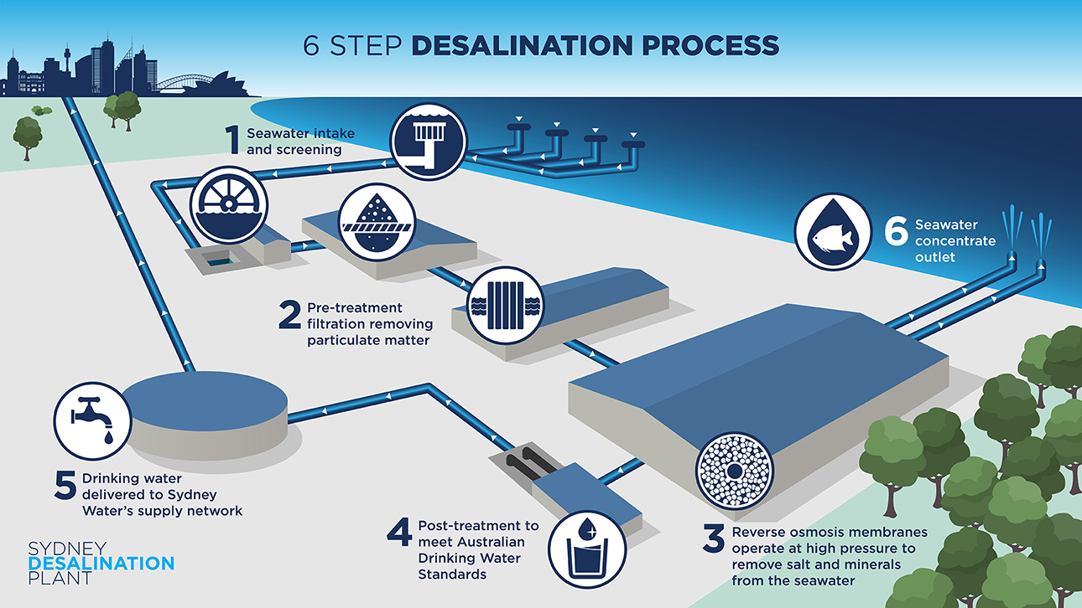
Flow chart

Slide 17
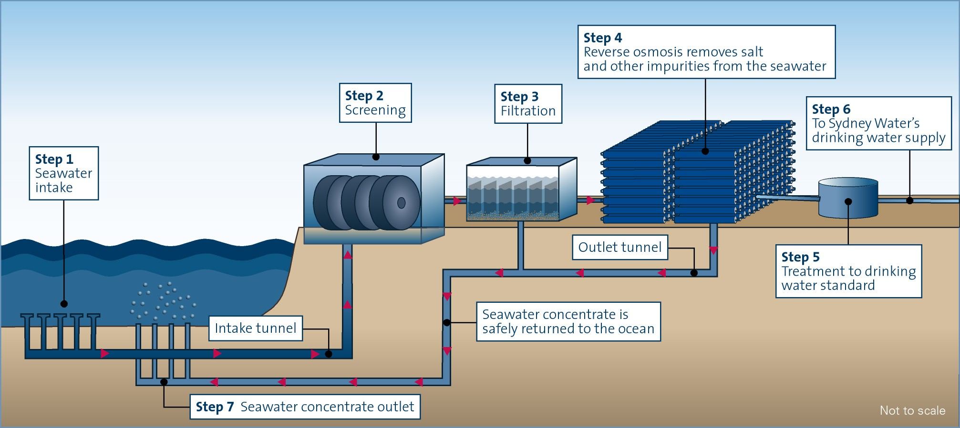
Flow chart

Slide 18
Membrane desalination
Electrodialysis (ED) - Membrane-Based Desalination
Principle
Process
Pros and cons

Slide 19
Electrodialysis (ED) - Membrane-Based Desalination
Principle
Process
Uses the principle of ion exchange to separate salts from water.
Saline water passes between alternating cation and anion exchange membranes.
An electric field drives positive and negative ions through their respective membranes, removing them from the water.
The result is desalinated water and a brine stream.

Slide 20
Electrodialysis (ED) - Membrane-Based Desalination
Pros
Cons
Suitable for low-salinity water.
lower power consumption than RO.
Unsuitable for high-salinity water.

Slide 21
In the second type(thermal desalination)
Multi-Stage Flash (MSF) Distillation
Multi-Effect Distillation (MED)
Vapor Compression (VC)

Slide 22
Thermal desalination
Multi-Stage Flash (MSF) Distillation
Principle
Process
Pros and cons

Slide 23
Multi-Stage Flash (MSF) Distillation
Principle
Relies on the principle of reducing the boiling point of water by lowering the pressure in successive stages.

Slide 24
Multi-Stage Flash (MSF) Distillation
Process
Saline water is heated to a high temperature.
In each stage, water is introduced into a low-pressure chamber, causing it to "flash" into steam.
The steam is condensed into freshwater using heat exchangers, while salts remain behind.
The process is repeated across multiple stages for efficiency.

Slide 25
Multi-Stage Flash (MSF) Distillation
Pros
Cons
Can handle high salinity water
Widely used in energy-rich countries.
high power consumption.

Slide 26
Thermal desalination
Multi-Effect Distillation (MED)
Principle
Process
Pros and cons

Slide 27
Multi-Effect Distillation (MED)
Principle
Uses the principle of reusing heat energy in successive stages to evaporate and condense water.

Slide 28
Multi-Effect Distillation (MED)
Process
Saline water is heated in the first stage to generate steam.
The steam is used to heat water in the next stage, where it evaporates at a lower pressure.
The process repeats over multiple effects to maximize energy efficiency.
Freshwater is condensed and collected at each stage.

Slide 29
Multi-Effect Distillation (MED)
Pros
Cons
higher thermal efficiency than MSF.
lower thermal consumption.
requires complex design and operational management.

Slide 30
Thermal desalination
Vapor Compression (VC)
Principle
Process
Pros and cons

Slide 31
Vapor Compression (VC)
Principle
Relies on the principle of compressing and reusing water vapor to reduce energy consumption.

Slide 32
Vapor Compression (VC)
Process
Saline water is evaporated, producing steam.
The steam is compressed, raising its temperature and pressure.
The compressed steam condenses to release heat, which is used to evaporate more water.
Freshwater is collected, and the brine is discharged.

Slide 33
Vapor Compression (VC)
Pros
Cons
high thermal efficiency.
suitable for small systems.
requires high operational cost for some applications.

